Slide 1

Introduction to Entrepreneurship: Week 2
Dr. Zunaira Saqib
SEECS

Slide 2

Week 2: The Entrepreneurial Mindset

Slide 3

What is a Mindset?
A “mindset” refers to the specific behaviours, attitudes, and thought processes that prompt our decisions. It encompasses how we view situations, obstacles, and our mental faculties.

Slide 4

What is an Entrepreneurial mindset?
A way of thinking that enables you to overcome challenges, be decisive, and accept responsibility for your outcomes. You must constantly improve your skills, learn from your mistakes, and act on your ideas. Anyone willing to do the work can develop an entrepreneurial mindset.
An entrepreneurial mindset helps leaders create value by “recognizing and acting on opportunities, making decisions with limited information, and remaining adaptable and resilient in conditions that are uncertain and complex. (MIT Sloan)

Slide 5

1. Solutions-Oriented
Resilient
Resourceful
Solutions-oriented
Lifelong knowledge-seekers
Curious and creative
Critical thinkers
Problem: Electricity Shortage
Solution: https://www.youtube.com/watch?v=g-1UcU-Jv4I&ab_channel=BBCNews%D8%A7%D8%B1%D8%AF%D9%88

Slide 6
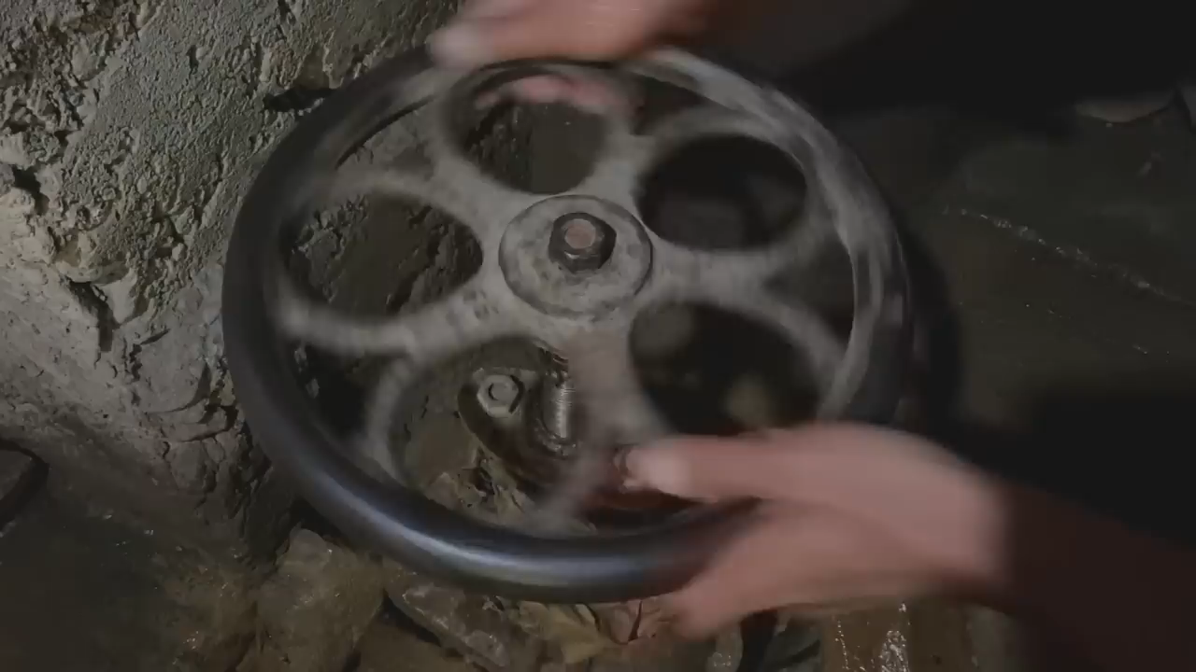

Slide 7

Are you a solution seeker?
Identify 1 problem
Give 2 solutions

Slide 8

2. Adaptable
Embrace change
Ambidextrous leaders (Managers and Entrepreneurs)
Adapt or Die
Netflix
Founded in 1997
Mailing DVDs to customers
Now 109 million subscribers worldwide

Slide 9

Which Businesses are Dying?
1 Example
How do they adapt?

Slide 10

3. Growth Oriented
Grow as people
Grow the business
Learn new things
Develop new skills
Explore new markets

Slide 11

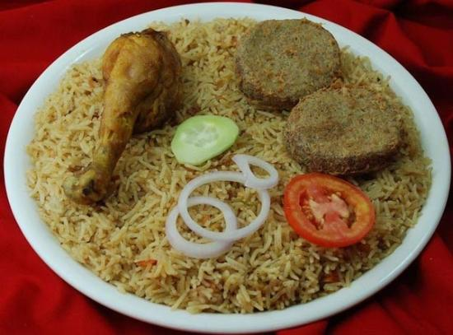
Growth – Why and How?

Slide 12
4. Independence and Accountability
Certain level of independence and faith in your own abilities is necessary to keep moving forward.
Taking ownership of your triumphs and errors
Reflect on how your actions impact yourself and others
What you’ve learned from your mistakes?

Slide 13

Are you independent and accountable?
Why are you in this degree?
Why are you in this University?
What do you want to do afterwards?
What is your biggest failure?
What is your biggest success?

Slide 14

5. Creativity and Risk Taking
This goes without saying.
Your solution has to be creative, new, fresh.
You have to learn to be uncomfortable and take risks

Slide 15
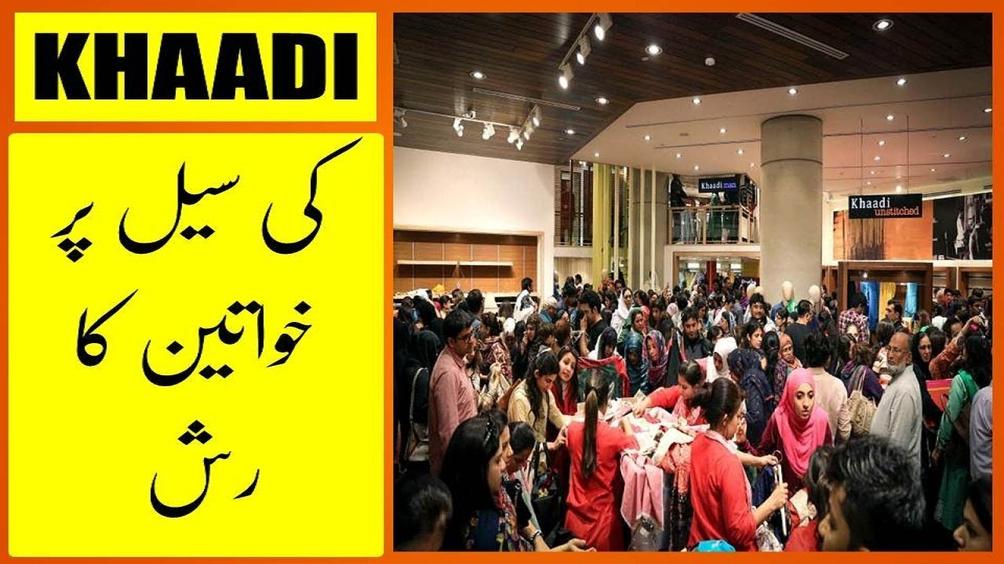
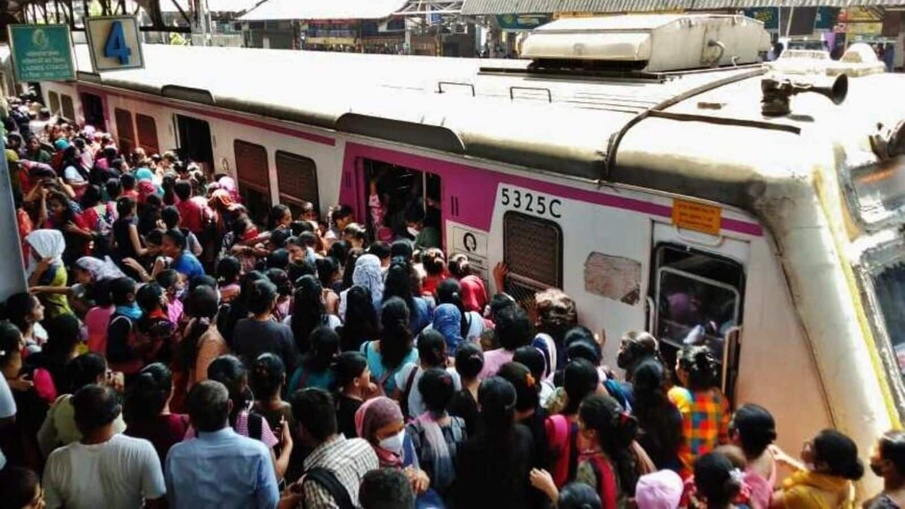

Slide 16

Class Activity
Take out any item from your bag / pockets / wallets.
Just one item

Slide 17
Week 3: Quiz 1 = 3%
Make a group of 3-5 people.
VISIT YOUR NEAREST SMALL BUSINESS (NOT IN NUST)
Preferred Options are Tandoor Wala (Naanbai), Shop around the Corner, Quetta Chai, Ice Cream / Chips Vendors
Make a 2 Minutes Video (Of the owner or main employee) Explaining how business is run and how can one start it.
Video Should Cover
What the business is?
Daily Sales and Daily Expenses
Daily Profit or Loss
Hardest Part of Running the Particular Business
Cost / Investment needed to start it from 0
Your own input of what they could do better to achieve more
You won’t be marked based on highest video quality but covering all aspects mentioned above. As long as video has clear voice and video, its fine. Do not focus on making a movie.
Make sure your group members names appear at the start of the video
Stay within the time limit (2 Minutes)
Give your innovative input at the end
Submission on LMS by one group member only by Thursday, 29th Feb, 11:55pm

Slide 18
Example Video
https://www.youtube.com/watch?v=Dxgm2yW-jDA&ab_channel=AAMINSAN
Please do not follow this to its entirety.
This is just to give you an idea.

